Slide 1
Triggers and Controllers

Slide 2
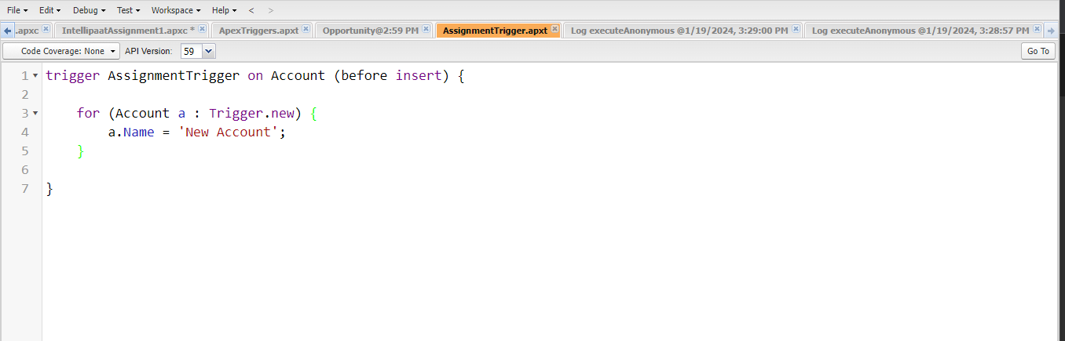
1)How to create triggers . Explain with example
A trigger is a piece of code that gets executed when certain criteria are met and when an operation on object happens.
e.g.

Slide 3
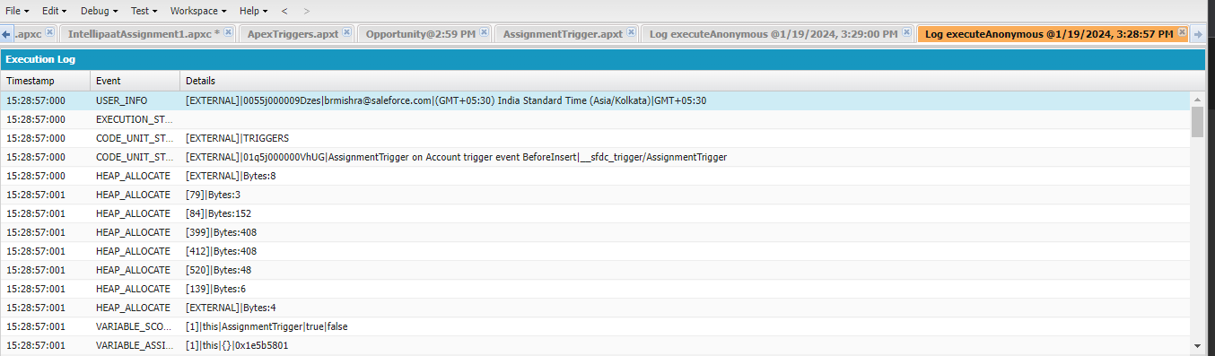
Below a trigger is fired when a new account is created.

Slide 4
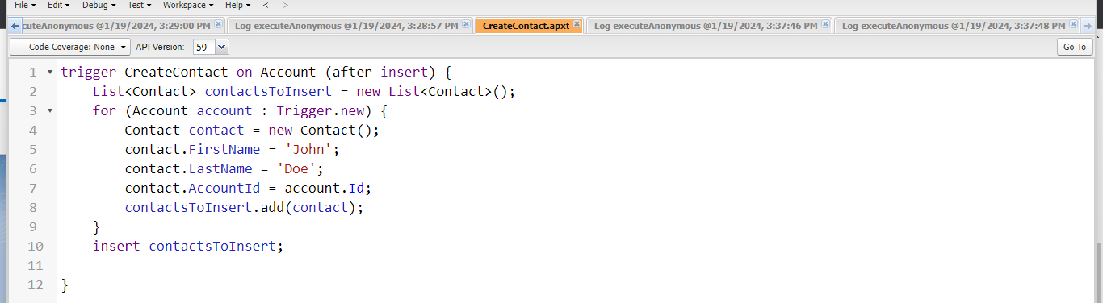
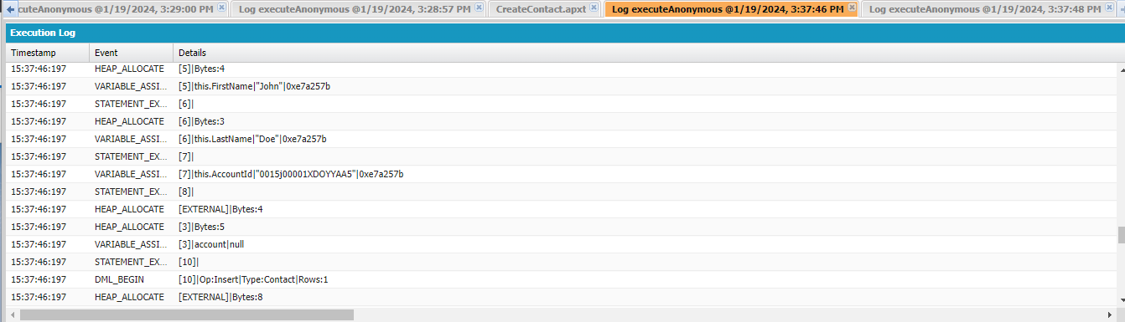
Write a trigger example to insert contact when you create account.

Slide 5
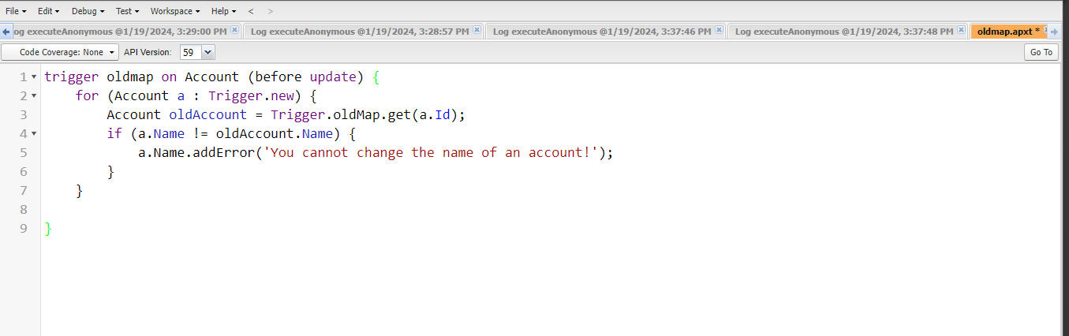
Explain trigger.oldMap with example
A map of old versions of sObject records before their updation or deletion.
E.g

Slide 6
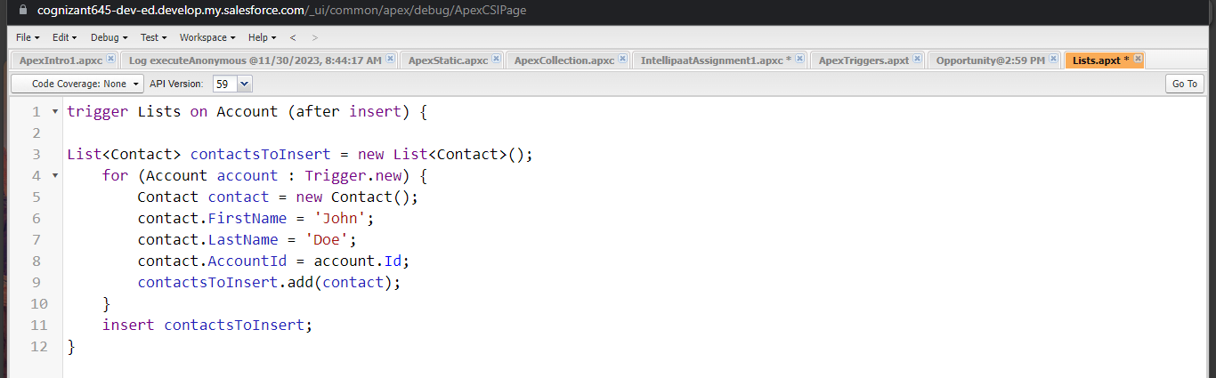
Write an example to create a list in apex trigger.

Slide 7
Write an example of creaing set and map in apex trigger
trigger AccountTrigger on Account (after insert) {
Set<String> accountNames = new Set<String>();
for (Account account : Trigger.new) {
accountNames.add(account.Name);
}
System.debug('Account Names: ' + accountNames);
}

Slide 8
trigger OpportunityTrigger on Opportunity (before update) {
Map<Id, Opportunity> oldOpportunities = Trigger.oldMap;
Map<Id, Opportunity> newOpportunities = Trigger.newMap;
Map<Id, String> opportunityNames = new Map<Id, String>();
for (Id opportunityId : newOpportunities.keySet()) {
Opportunity oldOpportunity = oldOpportunities.get(opportunityId);
Opportunity newOpportunity = newOpportunities.get(opportunityId);
if (oldOpportunity.Name != newOpportunity.Name) {
opportunityNames.put(opportunityId, newOpportunity.Name);
}
}
System.debug('Opportunity Names: ' + opportunityNames);
}

Slide 9
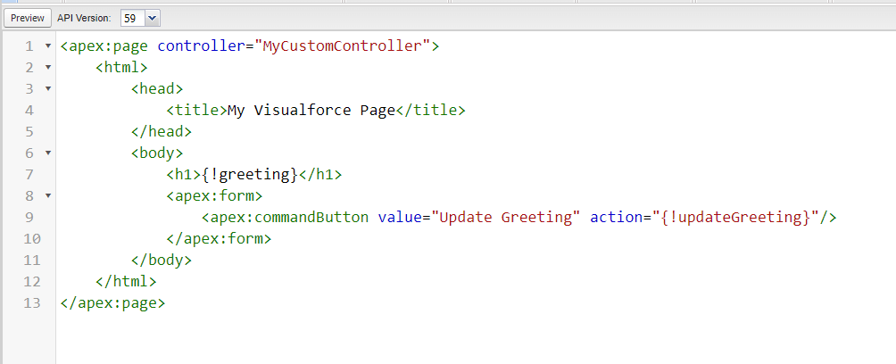
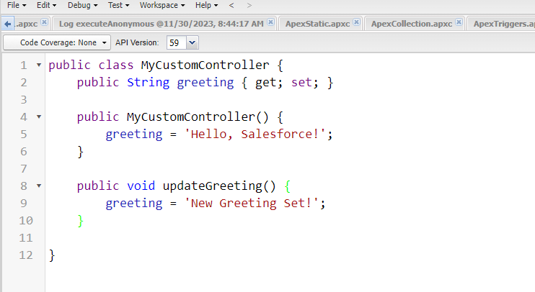
Design visualforce page using custom controller class.

Slide 10
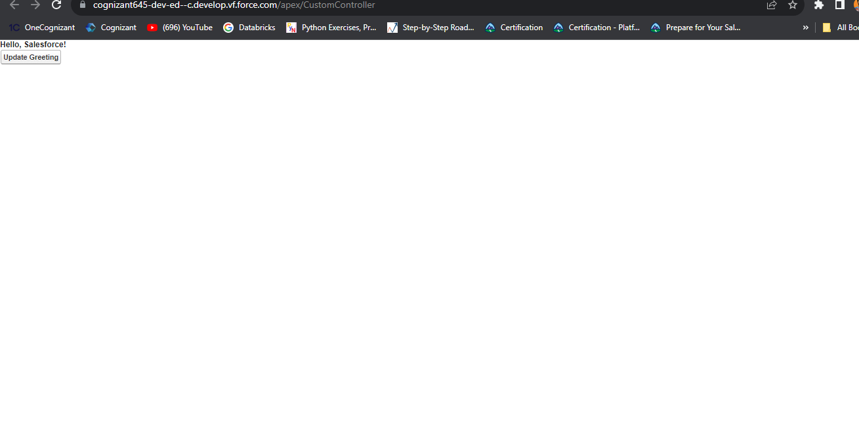

Slide 11
Design a visualforce page using custom controller extensions class

Slide 12
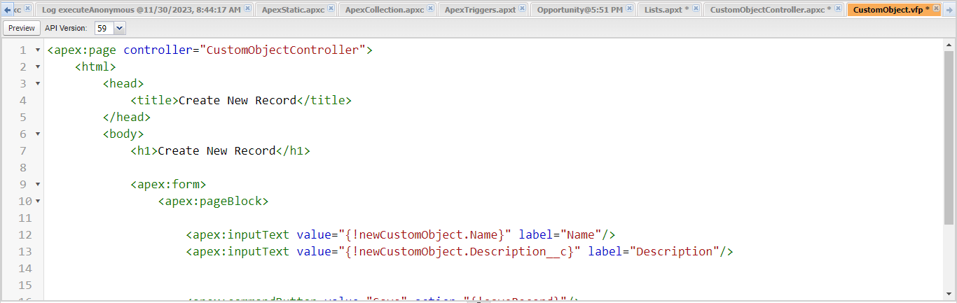
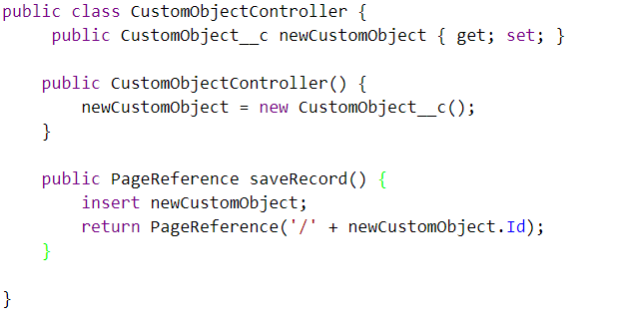
Write an example to create new records using custom controller

Slide 13
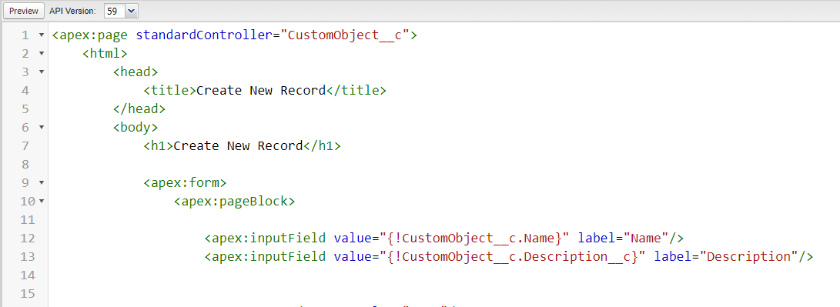
Write an example to manage new record using standard controller

Slide 14
Explain rendered function with example
Rendered function allows you to conditionally render or exclude a block of markup on the page based on a Boolean expression.
<apex:page controller="RenderedExampleController">
<html>
<head>
<title>Rendered Example</title>
</head>
<body>
<h1>Conditional Rendering Example</h1>
<apex:outputPanel rendered="{!displayBlock}">
<p>This block is rendered because displayBlock is true.</p>
</apex:outputPanel>
<p>This block is always rendered.</p>
</body>
</html>
</apex:page>

